Slide 1
Resolution-Writing Workshop
Earn 1 AMA PRA Category 1 Credit™

Slide 2
CME Information
Attendees will earn 1 AMA PRA Category 1 Credit ™
for participating.
Continuing Medical Education
The Texas Medical Association is accredited by the Accreditation Council for Continuing Medical Education (ACCME) to provide continuing medical education for physicians.
The Texas Medical Association designates this live activity for a maximum of 1 AMA PRA Category 1 Credit™.
Physicians should claim only the credit commensurate with the extent of their participation in the activity.
Notes:
On your table is a 4x6 blank notecard. As we go through this session, if at any time, you have an "a ha moment," please jot it down on the notecard at your table.
Jot a few things if you would like to. Maybe it is something you would like to implement or maybe it’s a “next step.” We would love to hear what it is.
You don't need to write your name on the card, just your thoughts. We will gather these at the end of the session today.

Slide 3
CME Disclosure
Policies and standards of the Texas Medical Association, the Accreditation Council for Continuing Medical Education, and the American Medical Association require that speakers and planners for continuing medical education activities disclose any relevant financial relationship they may have with commercial entities whose products, devices or services may be discussed in the content of the CME activity.
The content of this material does not relate to any product of a commercial interest; therefore, there are no relevant financial relationships to disclose.

Slide 4
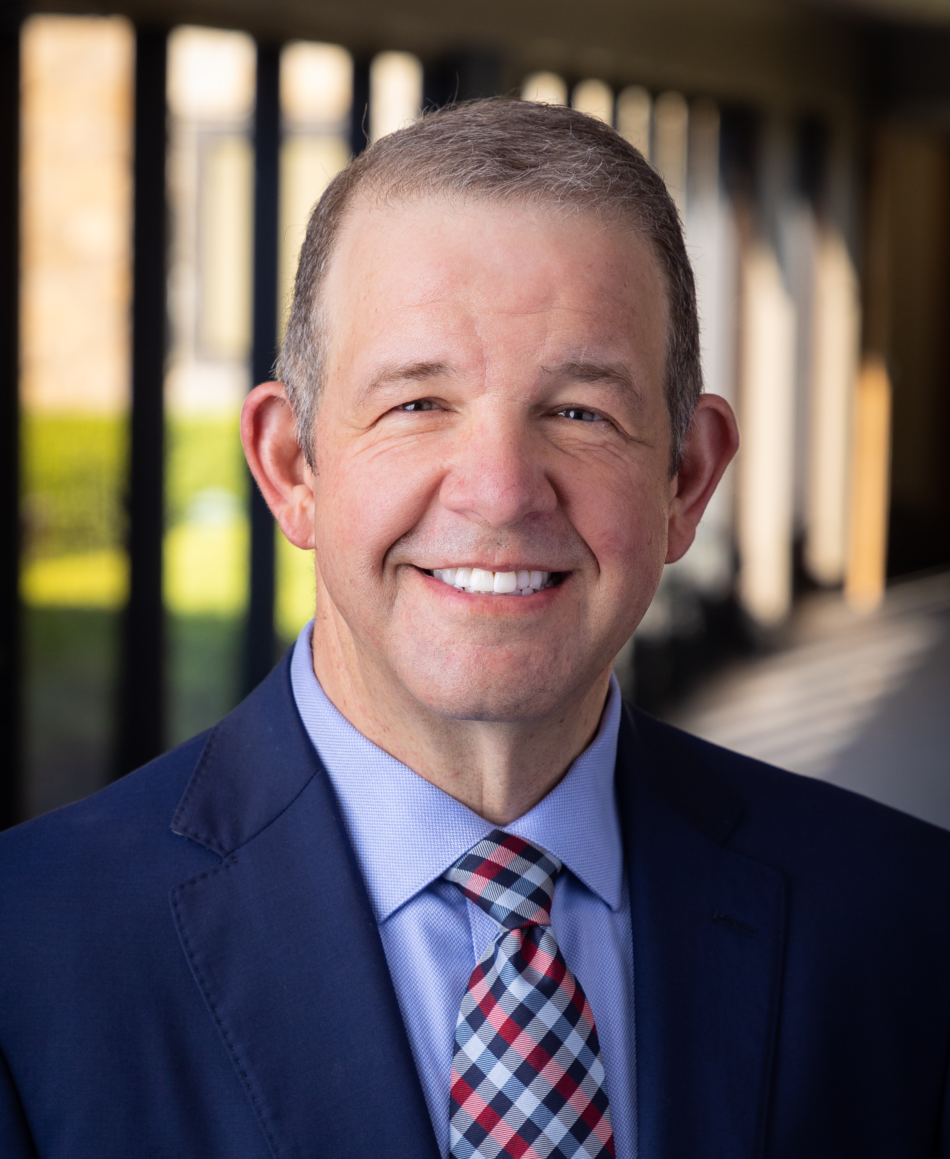
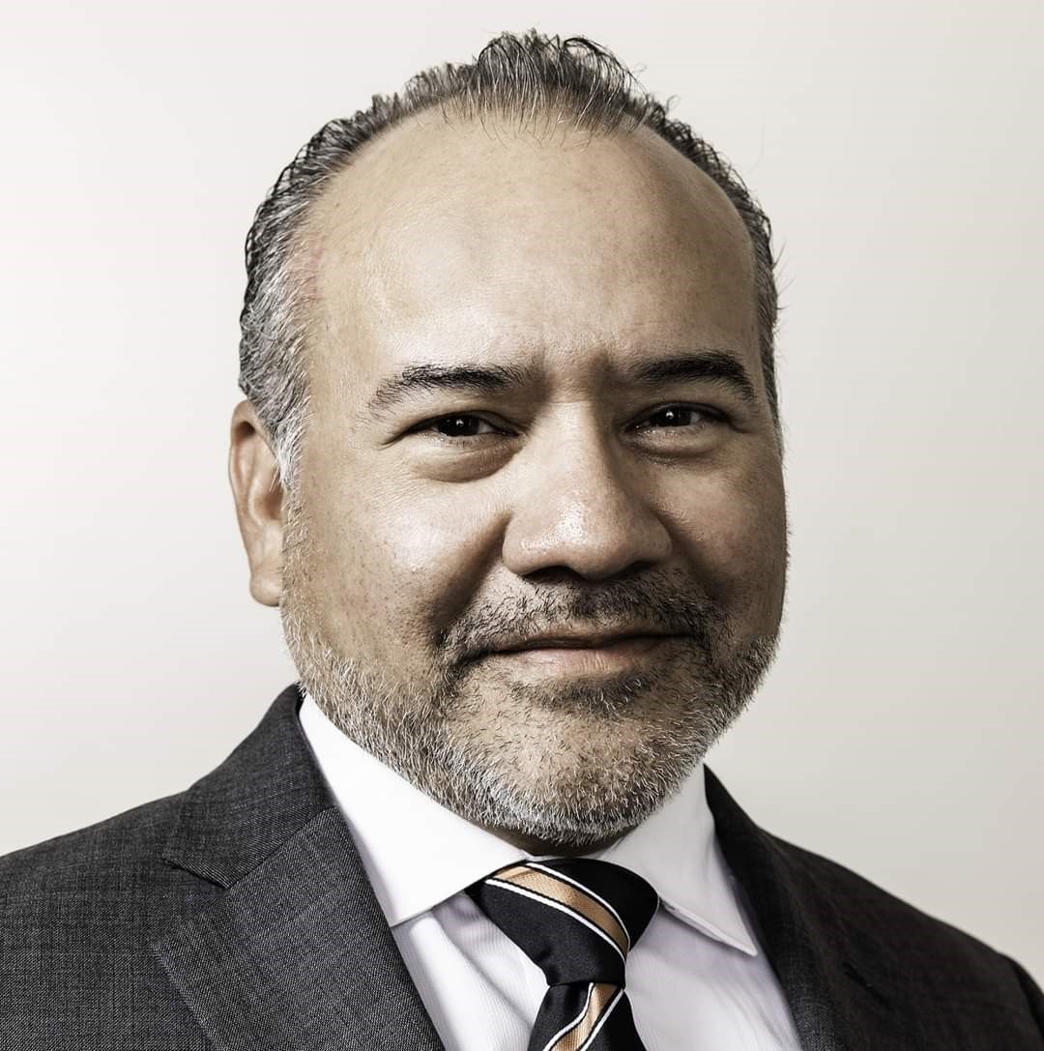
Welcome!
Physician Leaders
Bradford W. Holland, MD
Speaker
TMA House of Delegates
John G. Flores, MD
Vice Speaker
TMA House of Delegates

Slide 5
Program Objectives
Explain policymaking best practices, including:
  Define a resolution;
  Evaluate a resolution (weak or strong);
  Discuss what items are part of TMA’s scope of work; and
  Discuss what happens to a resolution once it goes to the House of Delegates.

Slide 6
What Is a Resolution?
A resolution is a formal expression of opinion, will, or intent voted by an official body or assembled group.

Slide 7
What Is a Resolution?
Titles and resolves are key
Consider your requested action
  Does it fall within TMA’s scope of work?
  Is it demanding vs. requesting?
Be specific
Be realistic
Rely on colleagues and mentors
What to consider for a strong resolution

Slide 8
Priorities of a Resolution
Title
Resolves
Research
Notes:
Talking Points: discuss the importance of prioritizing portions of the resolution such as title, resolves and research

Slide 9
Strong vs. Weak Resolution
Identify stakeholders
Seek additional support
Write concisely
  Separate out each item in a new resolve
  State the action you wish to the house to take
  Include any specific wording for addition to the TMA Policy Compendium
Research existing policy
Notes:
Talking Points: discuss how identifying stakeholders, seeking additional support, concise writing, researching existing policy, etc. creates a strong resolution

Slide 10
Subjects Within TMA’s Scope of Work
Resolution 310 2019: Restricting the Sale of Electronic Cigarettes to Minors
  Became TMA Policy 315.031
Resolution 403 2019: Prior Authorization Approval
  Became TMA Policy 235.040
Resolution 109 2022: TMA Open Meetings
  Will amend TMA Bylaws (pending 2023 house adoption)
Notes:
Resolution 310 in 2019: created policy supporting limiting the sale of e-cigarettes and associated products to those who are 21 years of age or older. This is now a Texas law.
Resolution 403 in 2019: created policy supporting that the criteria for prior authorizations be transparent, available to all physicians, kept to a minimum, and handled in a timely manner. TMA continues to advocate this position to legislators. The recent 2021 Texas "gold card" law gives physicians with a proven track record exemptions from the prior authorization process.
Resolution 109 in 2022: tasked the TMA Council on Constitution and Bylaws with drafting language allowing TMA members to request access to their council and committee meetings.

Slide 11
The Best Resolutions:
Help patients and physicians
Meaningfully alter TMA policy or positions in a way that a majority of TMA members support
Strengthen TMA
Are timely
Stick to the science and practice of medicine
Are sponsored by the largest contingent of TMA (your county, section, or delegation)
Notes:
Leave pure politics out!

Slide 12
Resolution Timelines
Start now!
Visit the House of Delegates webpage at www.texmed.org/HOD for updates and important dates and deadlines
Read the Speakers’ Letter
Notes:
Talking Points: remind members resolution writing starts now, visit the HOD webpage regularly for updates to important dates and deadlines, and the chair letter.

Slide 13
Breakout – Discuss/Record Ideas
Notes:
Physician leaders will wander the room during group work to help answer questions and provide feedback.

Slide 14
Wrap-Up – Review Ideas
Notes:
Talking Points: Review next steps including coordinating with other members/caucuses for support, input, feedback on resolutions; reminders of timelines; reach out to TMA leadership for questions/concerns; for additional guidance, staff is available.

Slide 15
Next Steps
Seek support, input, and feedback from:
  Colleagues and mentors
  Your county medical society
  Your caucus and sections
  TMA councils and committees
  Specialty societies
Remember timelines
Reach out to TMA leadership with questions/concerns
  Council and committee chairs and staff: texmed.org/BCCInfo
Notes:
You can find a list of all our TMA council and committee chairs and staff at texmed.org/BCCInfo.

Slide 16
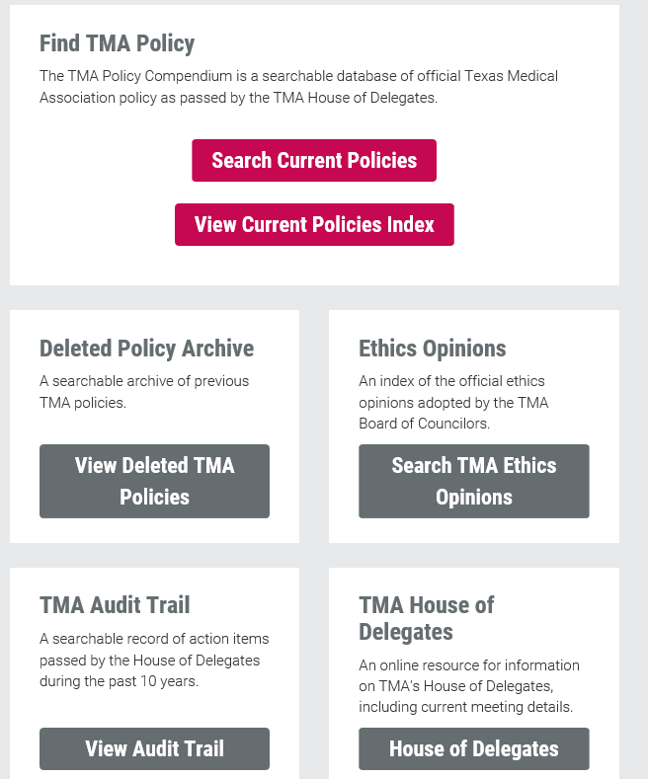
TMA Online Resolution Resources
www.texmed.org/HOD
www.texmed.org/Policy
House of Delegates Guide
Policy Compendium
Audit Trail
Election Process
Balloting Procedure

Slide 17
Final Tips
Do lots of research on the topic
Find out who is in opposition and exactly why, and discuss with them
Be familiar with online TMA resources
Ask for assistance from TMA staff
Confirm with TMA staff that the resolve is within TMA’s scope of work
Remember that titles and resolves are the key portions of the resolution
Work to obtain broad support early

Slide 18
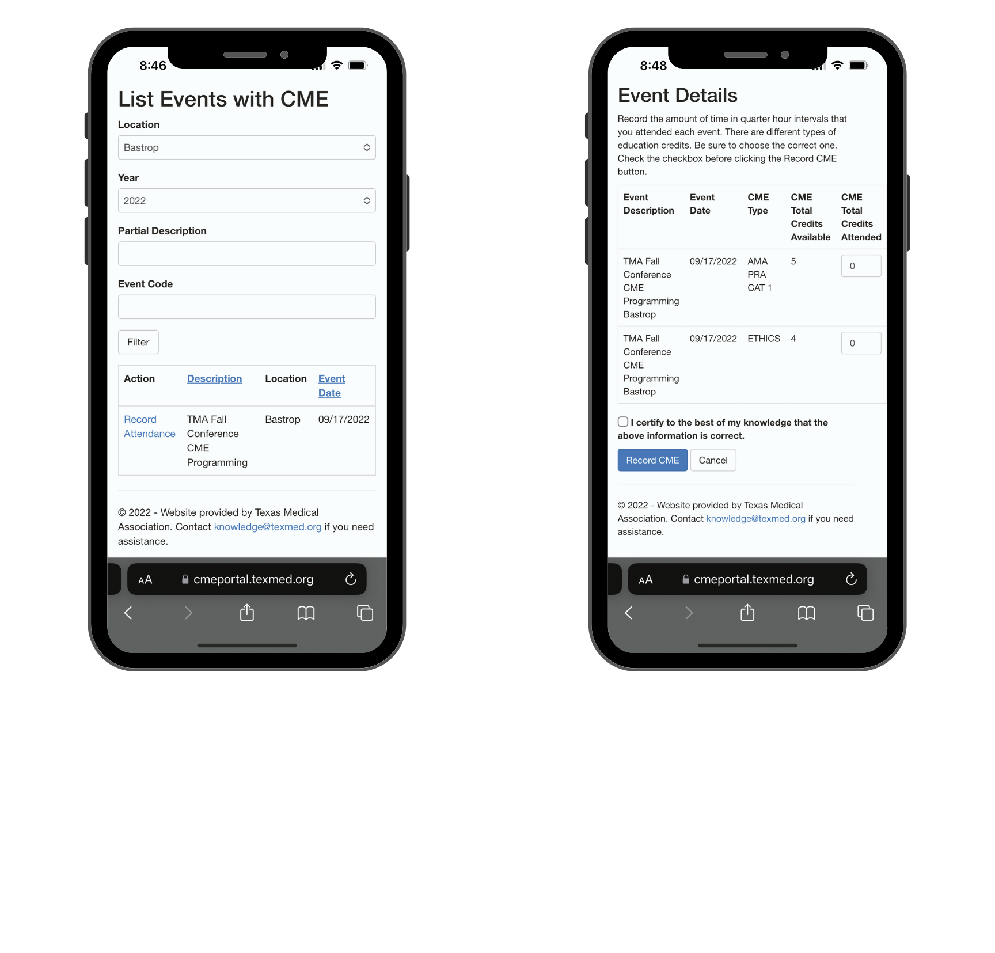
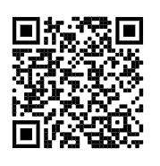
How to Report CME for Credit
1
Scan the QR code
Or go to:
https://cmeportal.
texmed.org/
Log in using your TMA website account log-in credentials.
Forgot your …
Username? Request a reset link at knowledge@texmed.org.
Password? Request a reset on the log-in page.
2
Filter Location & Year
3
Enter Your Credits
See Agenda for Credits per Session

Slide 19
Karen Kollar
Director, TMA Sections and Programs
(512) 370-1448
Karen.Kollar@texmed.org
Marti Francisco
Manager, HOD Governance
(512) 370-1307
Marti.Francisco@texmed.org

